Slide 1

Blinkit Sales Analysis
India's Last Minute App
A comprehensive Power BI analysis to optimize sales performance, customer satisfaction, and inventory distribution across all outlets.
Total Sales
Average Sales
Number of Items
Average Rating
Overall revenue generated from all items sold across channels
Mean revenue per transaction for performance benchmarking
Total count of distinct products sold in the catalog
Customer satisfaction metric across all purchased items

Slide 2

PRODUCT ANALYSIS
Sales Performance by Product Attributes
Total Sales by Fat Content
Analyze how fat content impacts total sales, with additional metrics including average sales per transaction, item count, and customer ratings. Visualization through a donut chart reveals the revenue split between low-fat and regular product categories.
Total Sales by Item Type
Fat Content by Outlet
Identify top-performing product categories using a bar chart comparison. Track how different item types contribute to revenue alongside average sales, item volume, and customer satisfaction scores.
Compare total sales across outlets segmented by fat content using a stacked column chart. Evaluate how fat preferences vary by location and their impact on key performance indicators.

Slide 3


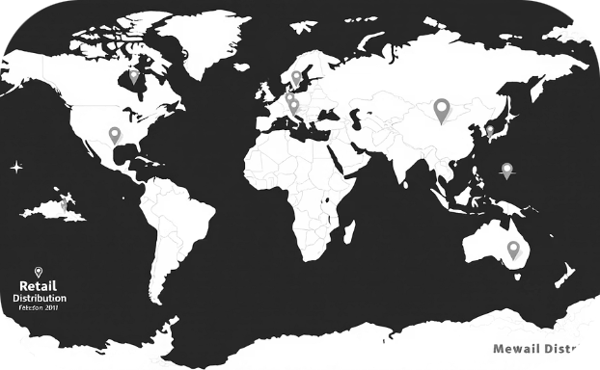
OUTLET ANALYSIS
Sales Distribution Across Outlets
Sales by Establishment Age
Sales by Outlet Size
Sales by Location
Line chart tracking how outlet age influences total sales performance and revenue trends over time.
Pie chart analyzing the correlation between physical outlet size and total sales contribution.
Funnel map visualization assessing geographic sales distribution and regional performance patterns.

